Slide 1



Stock Sentiment Analyzer
Hi!
Notes:
@Aruna - 15 sec - as a famous quote goes life big incident, changes the thinking perspective and bring creative ideas. Hence, the motivation of this project is the recent incident happened on the reddit wallstreet betting against stocks, where companies like Gamestock and AMC, who were almost on the verge of bankruptcy were turned into millionaire overnight.
@Transition statement - none

Slide 2
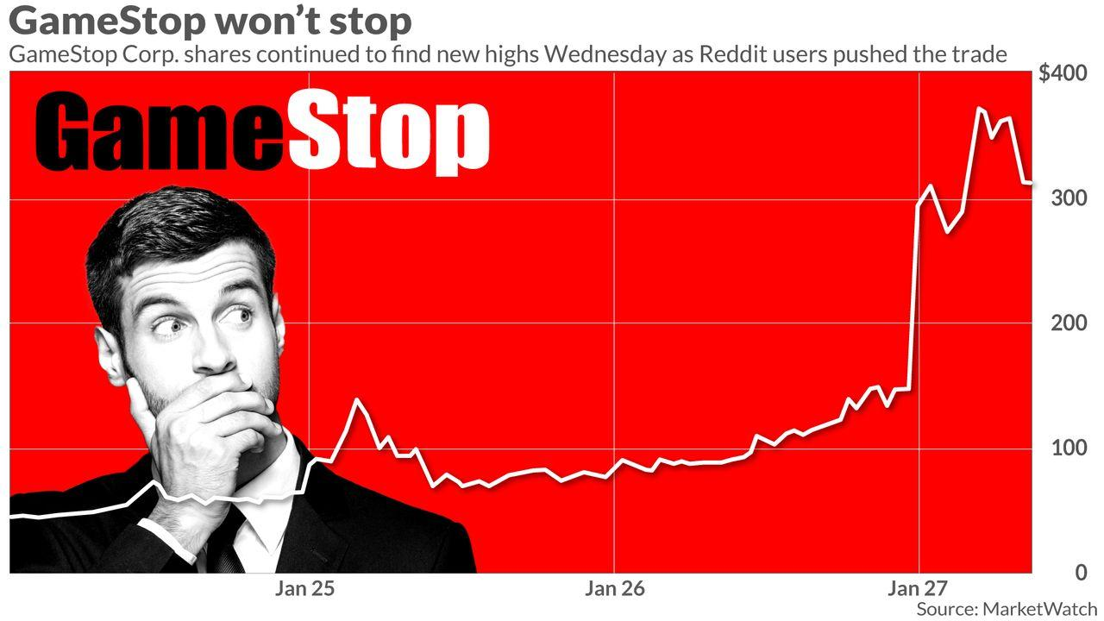

Motivation of this project !
Woo Gamestop wont Stop !
Notes:
@Aruna 15 sec -
@Transition statement - none
#to make informed decision and that’s exactly what we are trying to achieve..

Slide 3

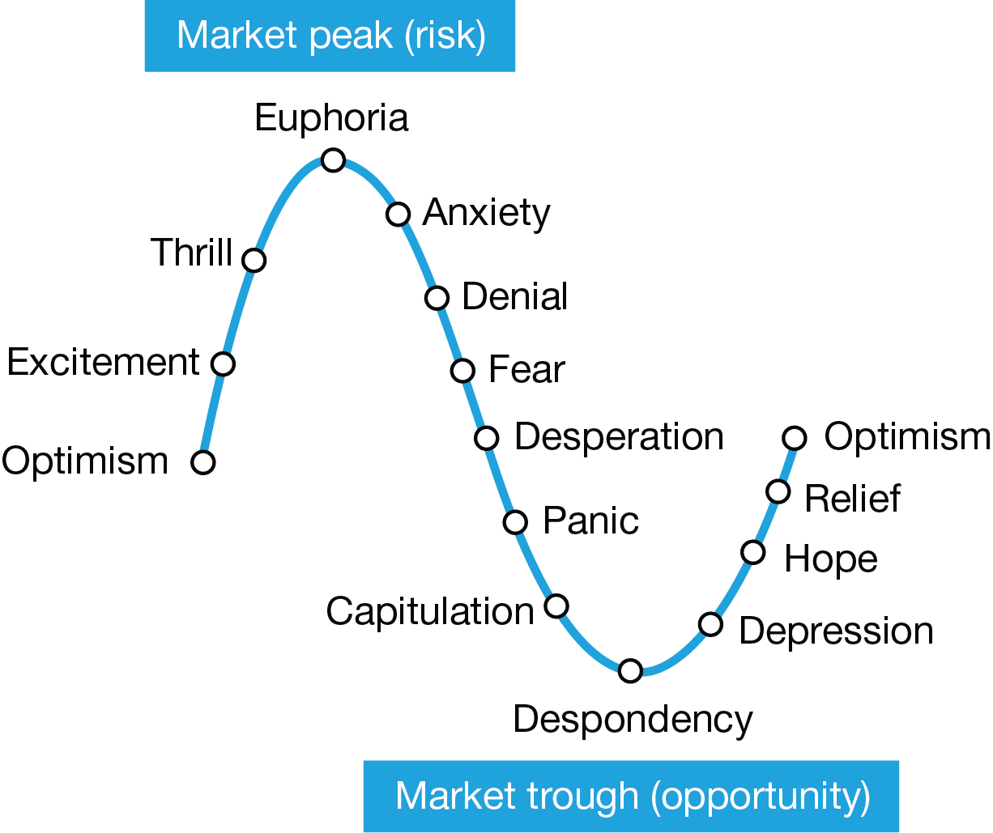
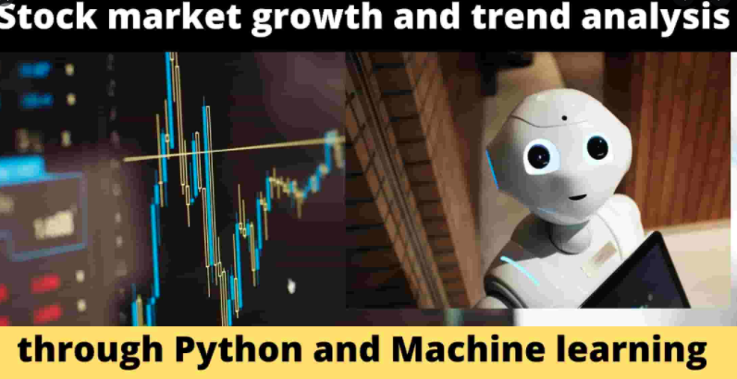



Use Case
& our Vision
Leverage public platform to predict market sentiment to buy / hold market
Notes:
@Aruna 30 sec -
Transition statement - I will handover to Aye who will walk through us the technologies we used.

Slide 4


Technologies used
Libraries
Libraries
Pandas
Pyviz
HvPlot
Matplotlib
Hvplot
Numpy
Tensorflow
Fastquant
Sentiment analysis library - NLTP , Textblot
Regular expression
ibapi library
Praw
Scikit
Python
HTML, CSS & Javascript
AWS
Jupyter Notebook
VS code
Github
Google Colab
Yahoo Finance
Notes:
@Aye - 1min - Well as Aruna walked you through our project goals, Here are libraries we used to achieve those goals.
@Transition statement - That being sad, I would handover to Aruna and Billy who will walk talk about data source and challenges we faced in the project

Slide 5

Steps and challenges in whole process
Data Source
Cleaning / challenges
Analyze
Reddit data volume > 20,000 rows (raw comments, URL, title, score) ; timeline of data ; Score comments, Alpaca API
Model training challenge ;
Machine learning model - NLTP and Textblot
Segregated sentiment & calculated % ; Industry wise sentiment ; Polarity; open&close
Special character, redundant data ; loading real time data problem; duplication; combining messy datasets
Notes:
@Aruna 1 min - Data source - (1) due to large volume of data,we pull only those comments which have high scores greater then 200, (2) we pulled raw comments, posting title, corresponding linke (3) from alpaca api - open and close prices of those stock
Cleaning process - took 70% of time (1) special characters (2) duplication and multiple stocks on same line (3)
Challenged - (2) Real time loading data
@Transition statement - none

Slide 6
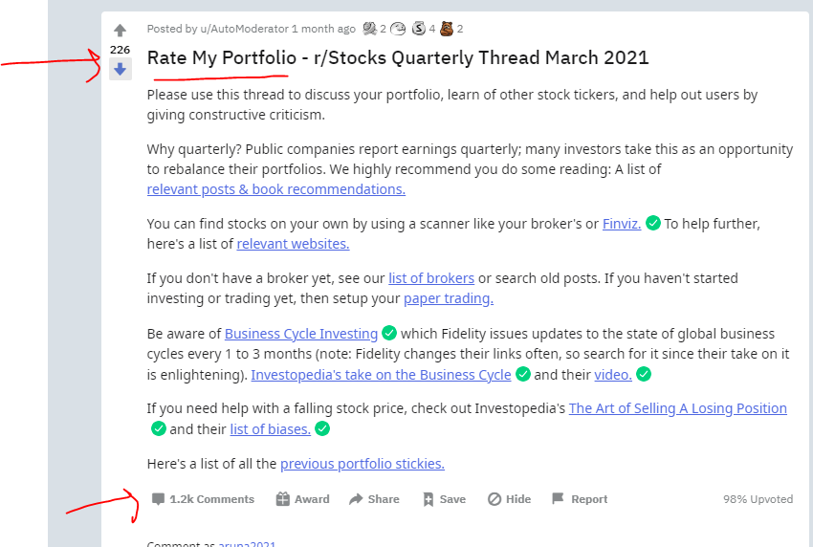
Reddit Data Volume - Challenge
Score
Special characters
Load more Comments
Notes:
@Aruna 15 sec -
@Transition statement - none

Slide 7
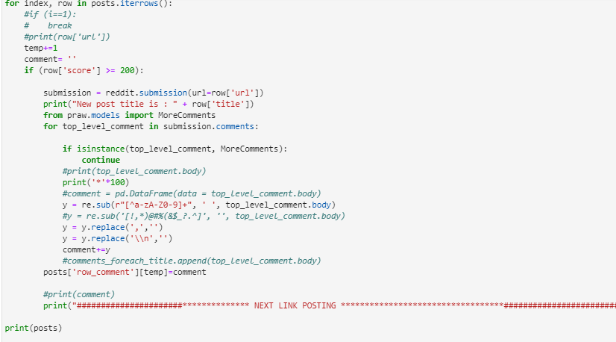
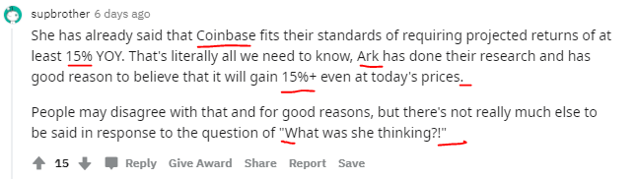
Cleanup special characters
Code
Reddit Post showing special characters to clean
CSV
Notes:
@Aruna - 15 sec -
@Transition statement - none

Slide 8
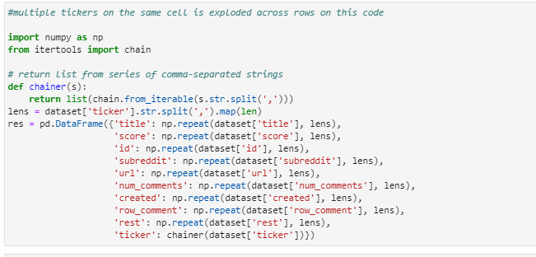
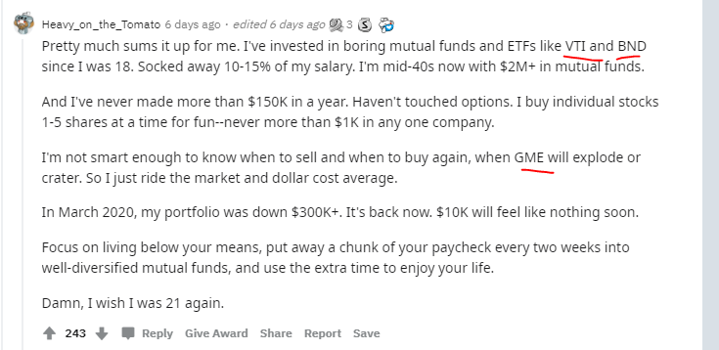
Cleanup exploding comments
Code
Reddit Posting bunch of stock stocks in same line
Notes:
@Aruna - 15 sec -
@Transition statement - none

Slide 9




ML Output dataframe
Alpaca API
Reddit
ML Result
Predict sentiments + , - & neutral from library NLTP
Predict polarity scale from library Text blot
Notes:
@Aruna -30 sec - Analyzre -
@Transition statement -

Slide 10
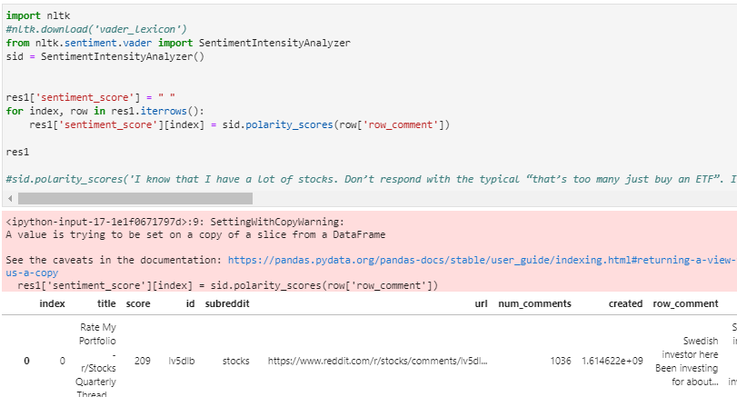
Machine learning library code
Code of last side results
Notes:
@Aruna - 2 sec - code
@Transition statement -

Slide 11
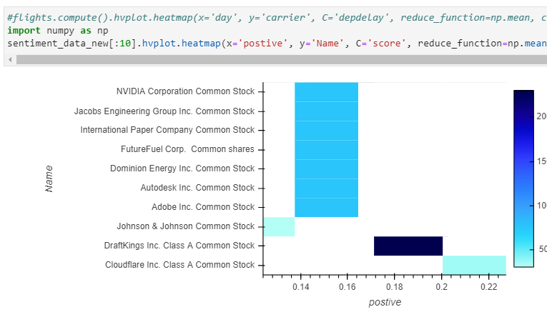
Polarity vs score

Slide 12
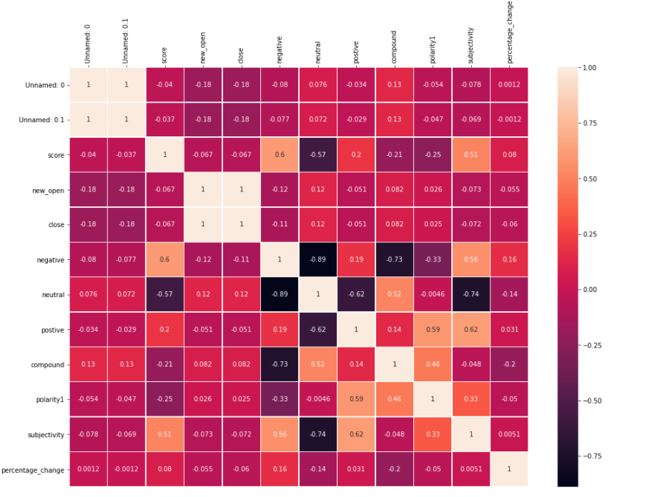
Correlation table between sentiments
Notes:
@Aruna - 30 sec -
@Transition statement - I would handover to Aye who will talk about % change in sentiments across different industries.

Slide 13

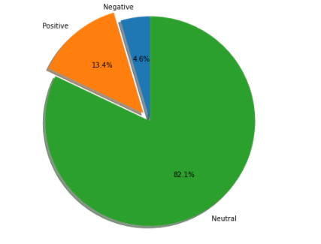
Overall market sentiments
Imbalanced dataset
Overall Neutral sentiment dominated but this varies from industry to industry
Notes:
@Aye-15 sec
@Transition statement - None
-

Slide 14
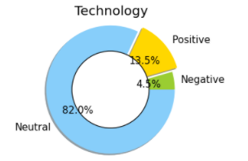
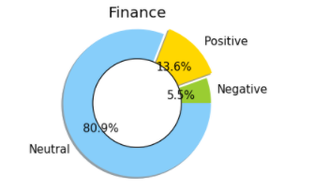
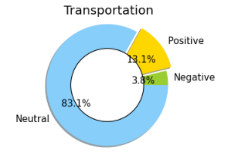
Sector Stocks Sentiments Percentages
4.5%
5.5%
3.8%
Finance (well fargo, Jp morgan etc.)
Transportation (American airlines, Delta, Alaska etc.)
Technology (FB,Google, Apple etc)
Notes:
@Aye 30 sec - - we all belong to different industries, so objective here is to to show high level overall sector specific stocks sentiments . Since we had real time data loading data issue and system inefficiency , so we took only couple month data and once if we take one year data then this would show more variations.
@Transition statement - That being said, I would handover to Bill who would talk about backtest and model performance evaluation metrics

Slide 15
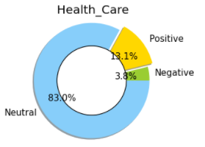
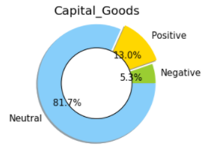
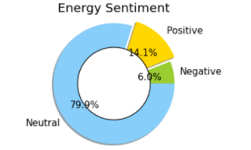
Industry Sentiment Percentages
3.8%
6%
5.3%
Health Care (eg. Pfizer, CVS Health etc)
Capital Goods(eg. Tesla,Boeing
Energy Sentiment (eg. Chevron, General electric etc.)
Notes:
@Ally - 30 sec - similarly with health care , capital and energy sector sector sentiments
@Transition statement - I would handover to Bill who will walk us through the historical cost data analysis.

Slide 16
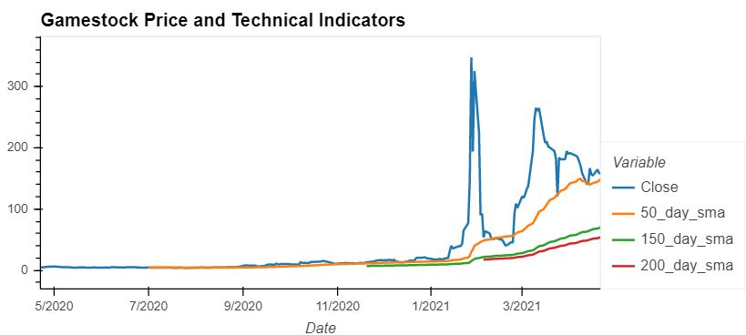
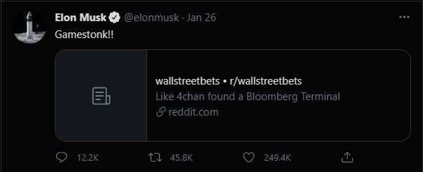
GME - King of Market Sentiment
Notes:
@Billy - 30 sec
dfv
Jan 26 - 147 close, 27 - 354 open, 140% increase

Slide 17
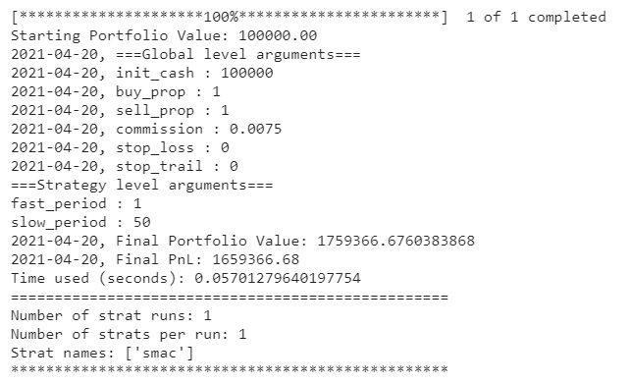
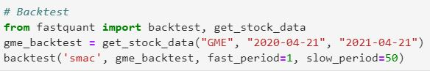
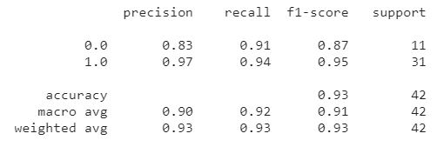
Backtest
GameStop Corporation Common Stock
Notes:
@Billy - 30 sec
Fastquant library (only used 50 day sma since never crossed higher smas), 1,659.37%.

Slide 18
Confusion matrix

Slide 19

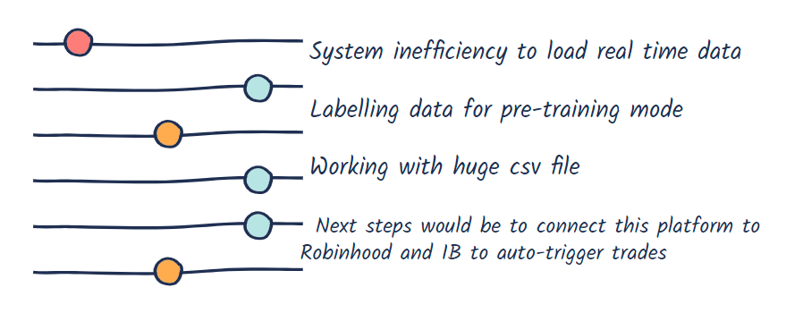
Limitations and Next Steps
Notes:
@Aruna - 30 sec- We struggled with lot of limitation and one of the biggest limitation was system inefficiency to load huge columous data, due to which was having issue to make it real time. Due to time constraint we couldn’t do second step to connect to trading platform. However we are definitely planning to pursue this tangible product .
@Transition statement - I would handover to to Aruna who will give real time demo

Slide 20

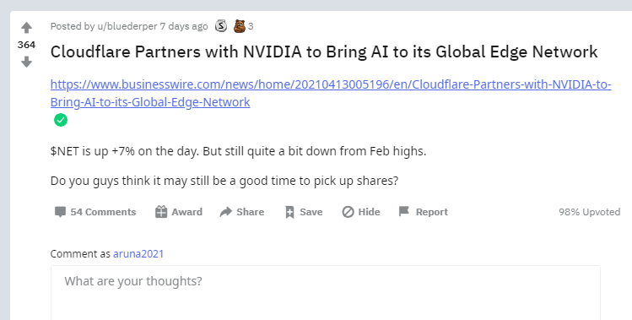
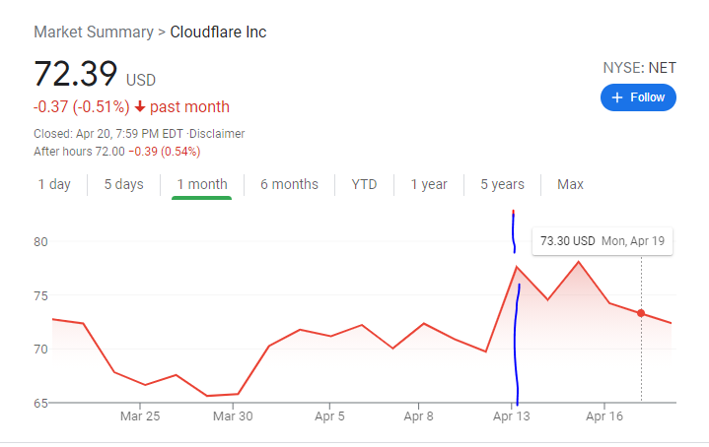
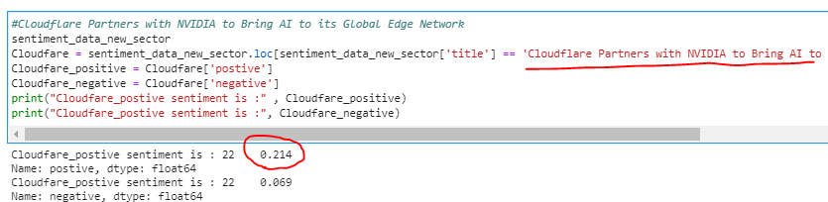
Validating results -spot check
Reddit Posting
Real Stock price
Code result
Notes:
Aruna 15 sec - before moving to demo, i would like to show some validations we did through spot checks and it predicted correct on untrained data like seen from the snapshot
@Transition statement -

Slide 21
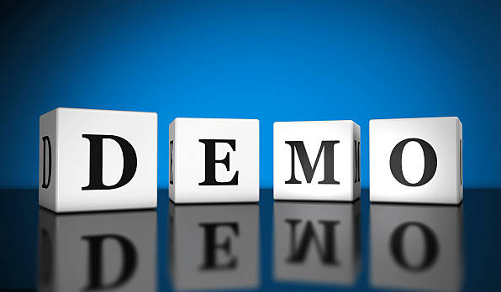
Demo
Product
Notes:
@Aruna - 1min
@Transition statement - none

